Slide 1



UNIT 6:
Around the world
Around the world

Slide 2
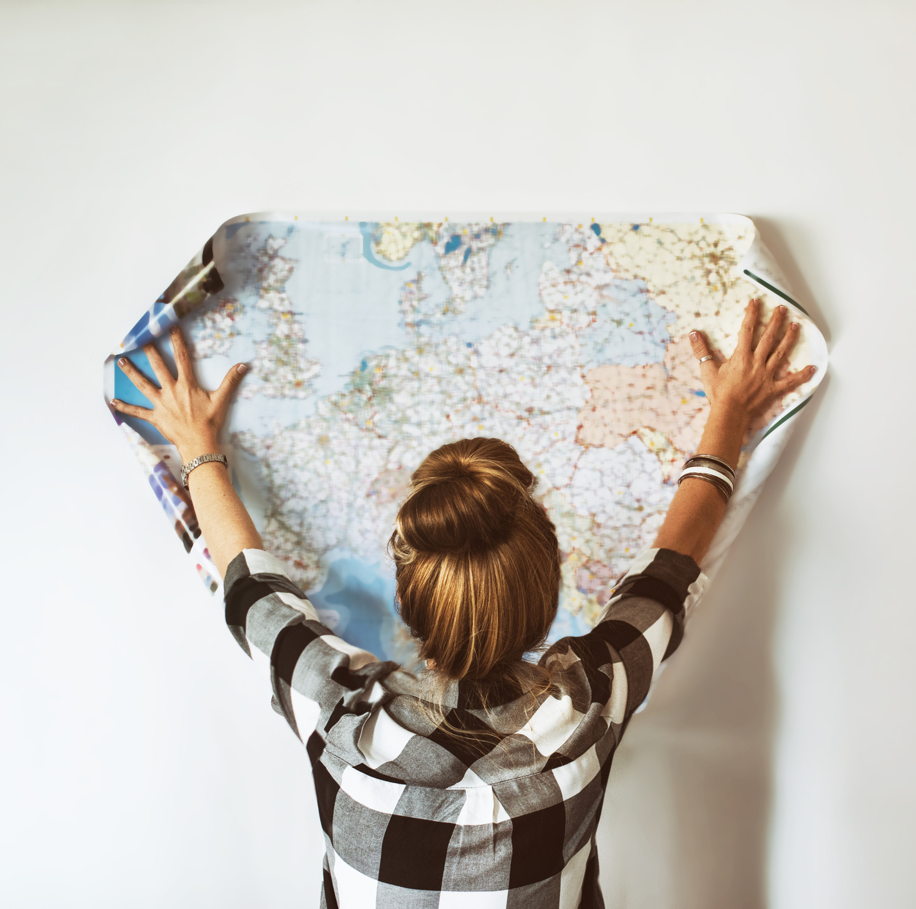
What’s your favourite place in the world?
Why do you like it?
Which cities would you like to visit? Why?

Slide 3
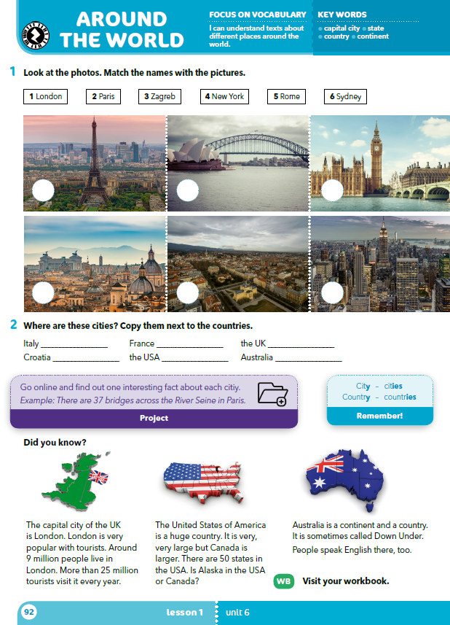
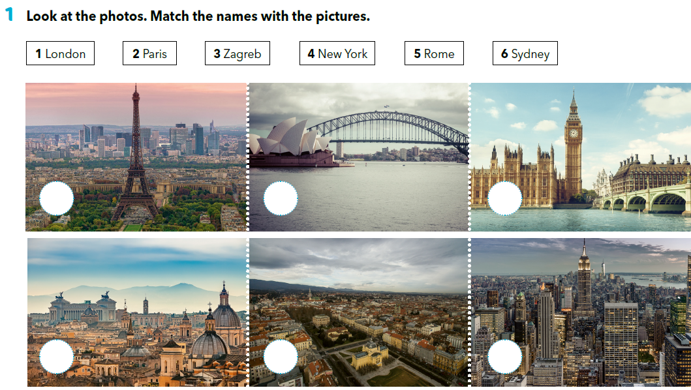
What can Can you name these cities?
Where are they?
2
6
1
5
3
4

Slide 4
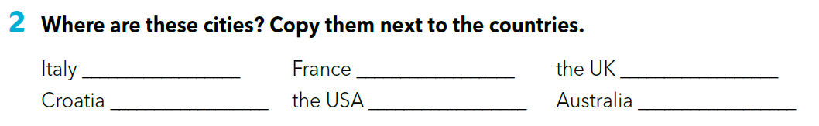
Rome
Paris
London
Zagreb
New York
Sydney
What do you know about these cities?
What about the countries?
Do you know any people who live there?
Do you know any other cities from these countries?
What are they famous for?

Slide 5
Choose one of the cities from task 1 and find more information about it online:
  facts about the country they’re in
  famous landmarks (why are they famous?) famous people born there
  interesting facts
Find other classmates that chose the same city and compare the information that you found.

Slide 6
Form a group of 6 pupils.
Each member of the group should have the information about a different city. Listen to the others about their cities and then share with them what you found out about ”your” city.

Slide 7
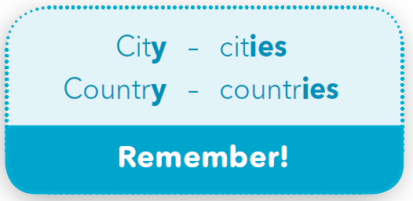
Look at the examples. What’s the plural form of these words?
If the word ends in a consonant + ”y”, we change ”y” in ”i” and add the suffix ”-es”.

Slide 8
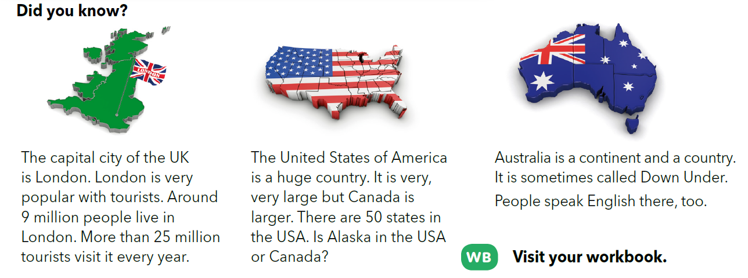
What can you see in the pictures?
Which countries are these?
Read the texts and say one thing that you learned from them.
What more do you know?

Slide 9
Read the text aloud.
Add an extra information about that country that you know.

Slide 10
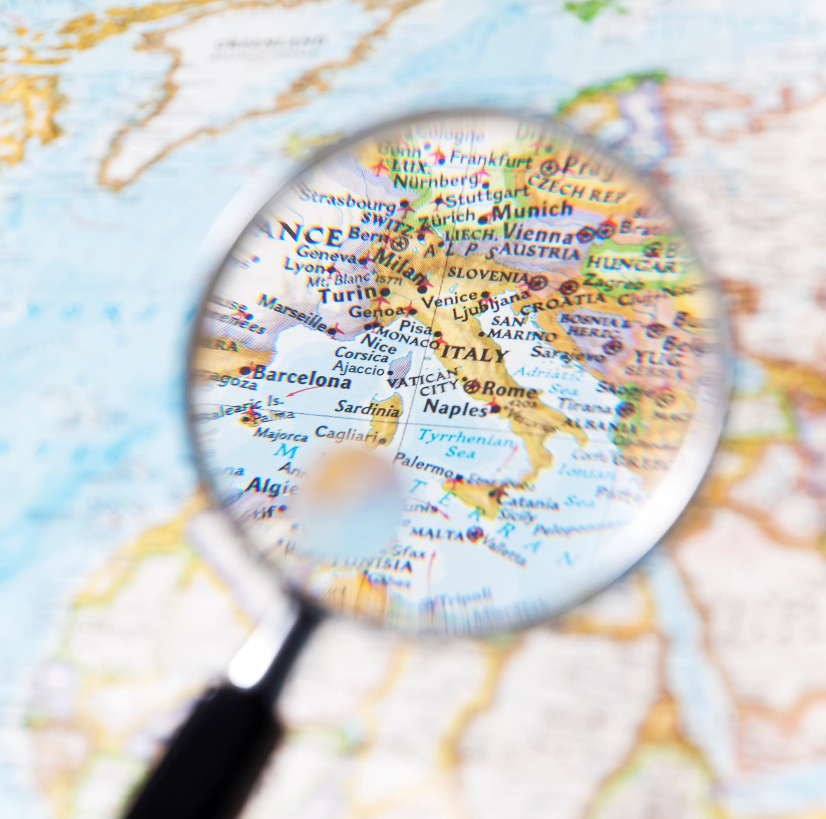
Write a short text about Croatia, Italy or France in pairs or on your own.
Use the texts from task 3 as example

Slide 11
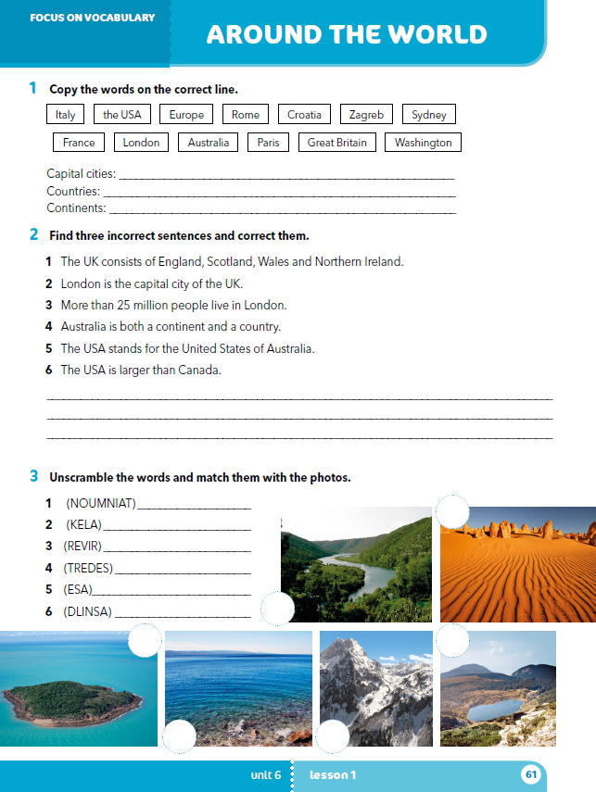
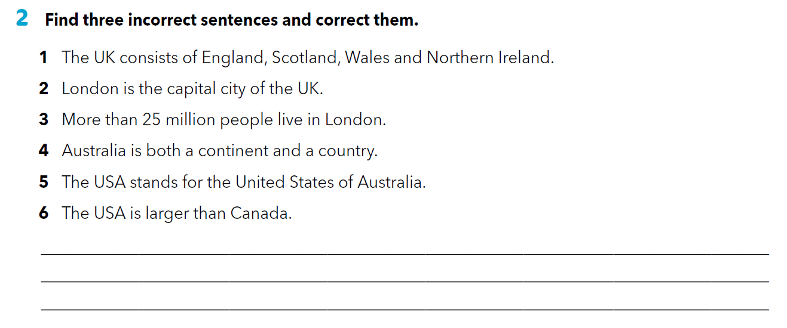
Workbook p 61.
3 Around 9 million people live in London.
5 The USA stands for the United States of America.
6 The USA is smaller than Canada.

Slide 12
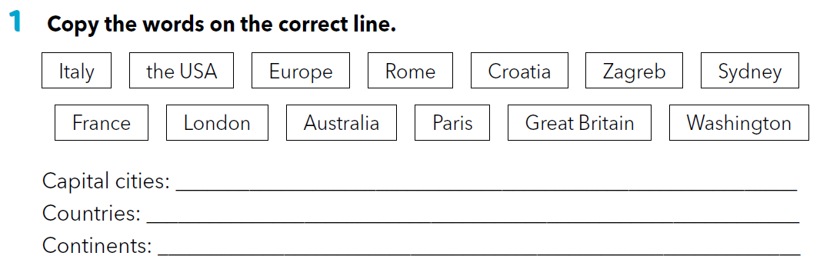
Rome, Zagreb, Sydney, London, Paris, Washington
Italy, the USA, Croatia, France, Australia, Great Britain
Europe, Australia

Slide 13
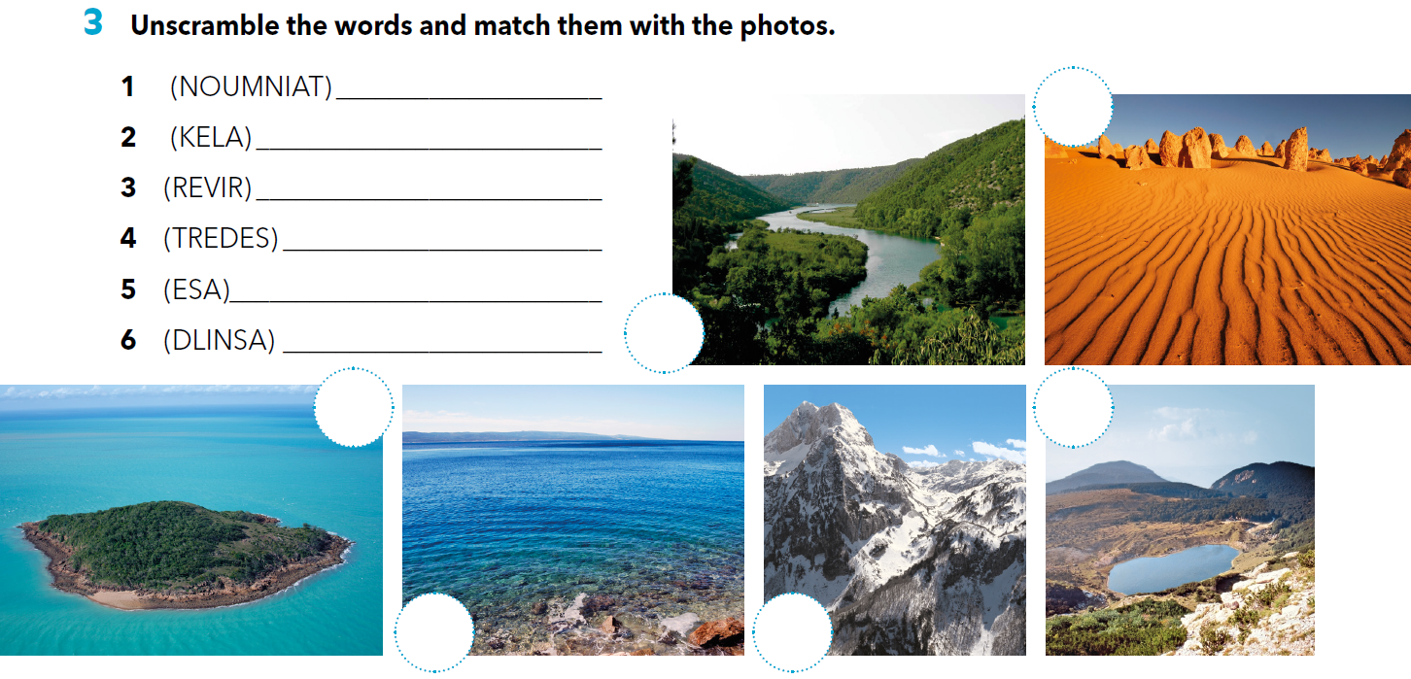
mountain
lake
4
river
desert
sea
island
3
6
2
5
1

Slide 14
LET’S REVISE!
How much do you remember about the cities and countries that are mentioned in this lesson?
Match the picture with the correct city.
.
https://www.bookwidgets.com/play/t:g+yLe2hJgaGsKx3XQmp91kHCCzfGfPyAIS1pZdWMsvlaRU5TVFo=

Slide 15

SELF CHECK.
https://www.e-sfera.hr/dodatni-digitalni-sadrzaji/0bdd2a1f-c2ae-4906-b3b4-e664160653b1/

Slide 16
LEARN MORE.
https://www.e-sfera.hr/dodatni-digitalni-sadrzaji/0bdd2a1f-c2ae-4906-b3b4-e664160653b1/
They speak English, too!

